Slide 1
Singapore Travel Guide Project Milestone #2 Code Monkey Team

Slide 2
Outline
Overview
UI Design Diagram
Image Processing
Car Detection
SQL
Cloud Architecture
Web Server On Cloud
Image Processing On Cloud
Elasticity & Scalability
Implementation Plan
14 Jul

Slide 3
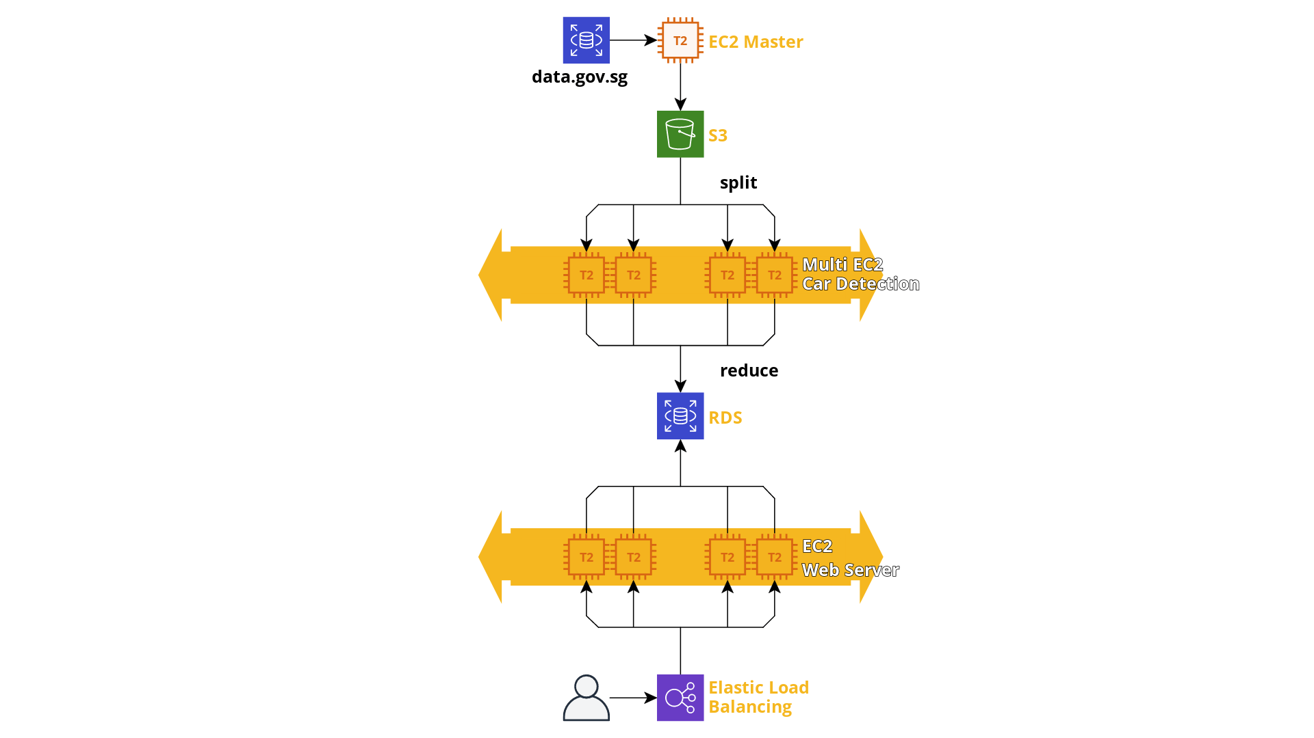
Overview
14 Jul

Slide 4
Outline
Overview
UI Design Diagram
Image Processing
Car Detection
SQL
Cloud Architecture
Web Server On Cloud
Image Processing On Cloud
Elasticity & Scalability
Implementation Plan
14 Jul

Slide 5
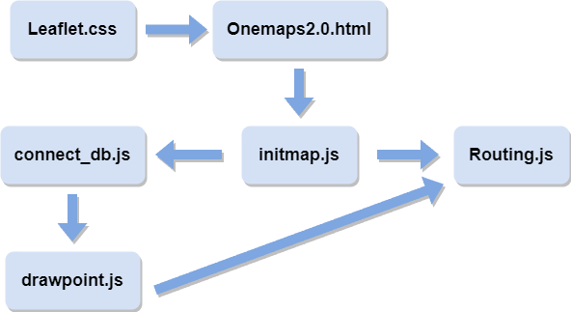
UI Design Diagram
When the user enters the start and end points, Routing.js draws the line on the map
To show all the the location of all cameras on the map, as well as the number of vehicles
More features?
14 Jul

Slide 6
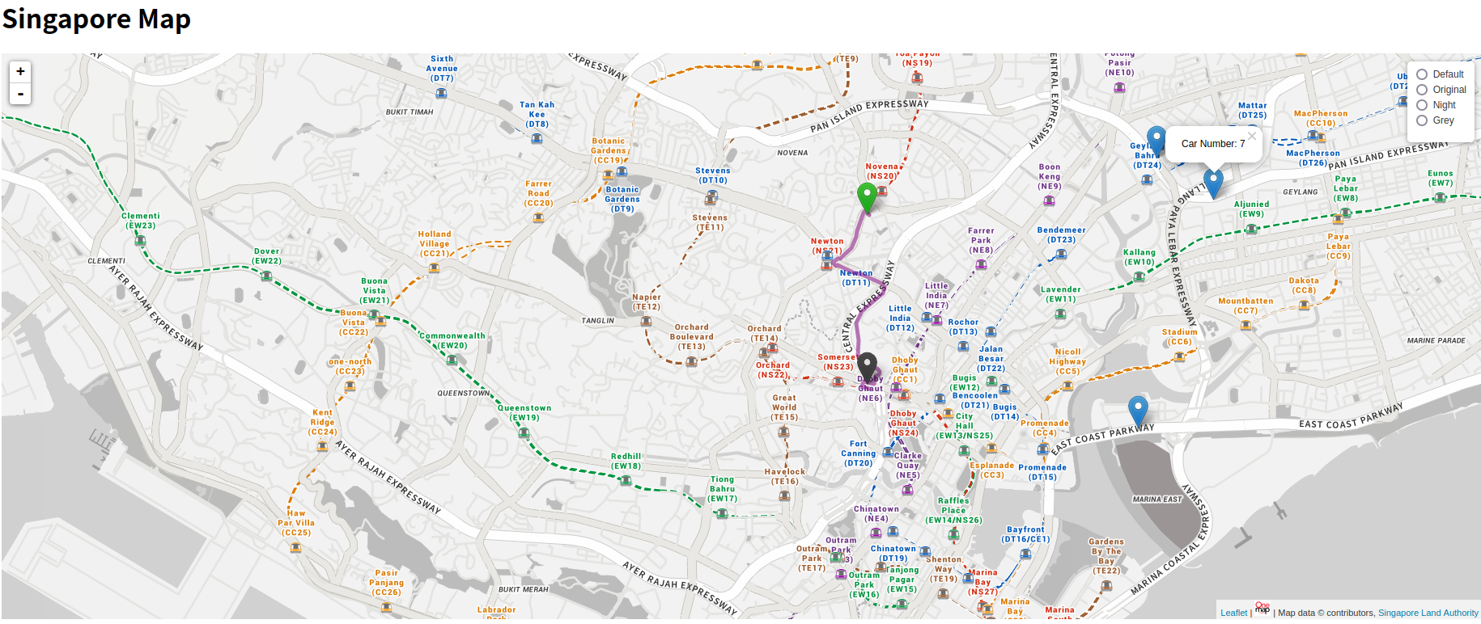
UI Design Diagram
14 Jul

Slide 7
Outline
Overview
UI Design Diagram
Image Processing
Car Detection
SQL
Cloud Architecture
Web Server On Cloud
Image Processing On Cloud
Elasticity & Scalability
Implementation Plan
14 Jul

Slide 8
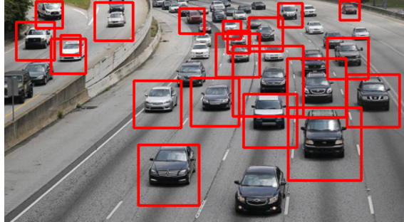
Image Processing
Car Detection
We will use machine learning to count the num of cars
We use anchor boxes to mark cars and count the num of anchor boxes
The program runs every 5 minutes to fetch the data from data.gov.sg and process it in AWS EC2
14 Jul

Slide 9
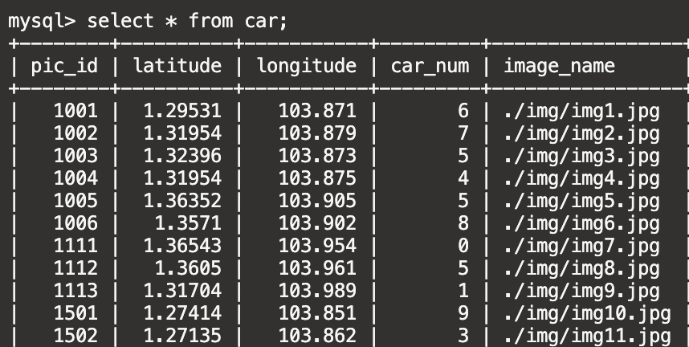
Image Processing
SQL
We use AWS RDS to store the result.
The front-end will get the information from SQL and print it in the map.
For each camera , we have its camera id as its primary key and location to mark it on the map.
14 Jul

Slide 10
Outline
Overview
UI Design Diagram
Image Processing
Car Detection
SQL
Cloud Architecture
Web Server On Cloud
Image Processing On Cloud
Elasticity & Scalability
Implementation Plan

Slide 11
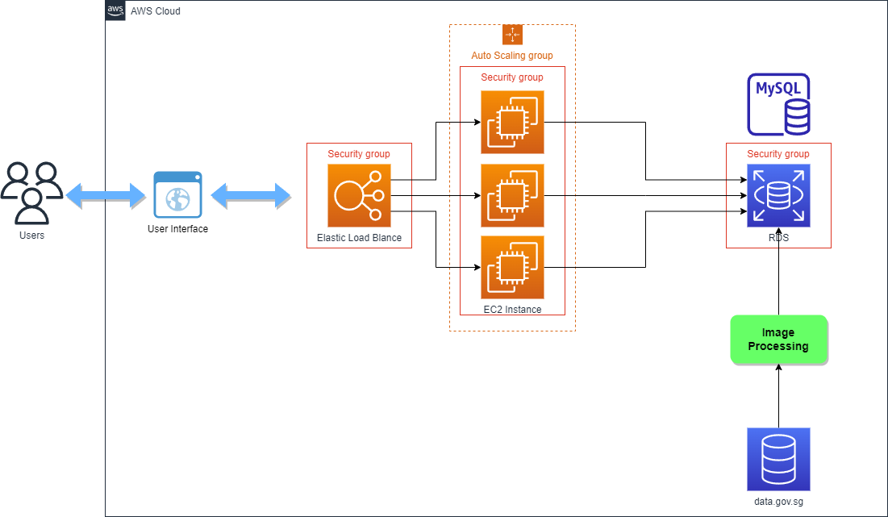


Cloud Architecture
Web Server On Cloud
NodeJS & Express
Serve static web content
Process HTTP requests from frontend
Use MySQL statement to get data from RDS
Web Server
IaaS
14 Jul

Slide 12
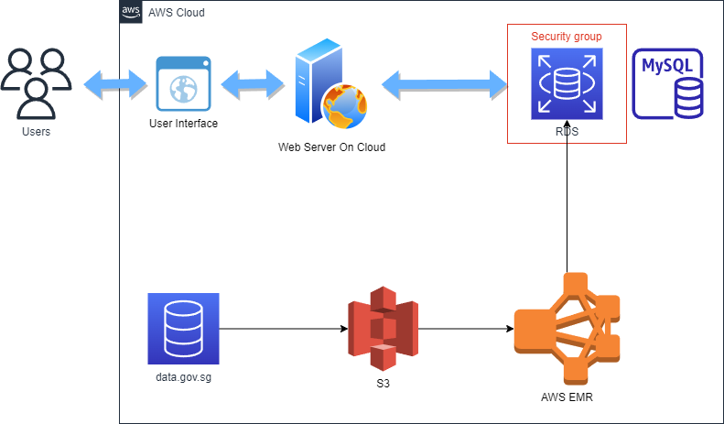

Cloud Architecture
Image Processing On Cloud
Python
OpenCV API
Map&Reduce
Large Dataset
Parallel makes Efficiences
Image Processing

Slide 13
Cloud Architecture
Download
Workflow
14 Jul

Slide 14
Cloud Architecture
Download
Workflow
Store Images
14 Jul

Slide 15
Cloud Architecture
Download
Workflow
Store Images
Map&Reduce
Machine Learning
14 Jul

Slide 16
Cloud Architecture
Download
Workflow
Store Images
Map&Reduce
Machine Learning
Update to the database on cloud
14 Jul

Slide 17
Cloud Architecture
Download
Workflow
Keep Running in the background
Download and process every 5 mins
Store Images
Map&Reduce
Machine Learning
Update to the database on cloud
14 Jul

Slide 18
Cloud Architecture
Download
Workflow
Keep Running in the background
Download and process every 5 mins
Store Images
Map&Reduce
Machine Learning
Update to the database on cloud
Users interact with Web UI
14 Jul

Slide 19
Cloud Architecture
Download
Workflow
Keep Running in the background
Download and process every 5 mins
Store Images
Map&Reduce
Machine Learning
Update to the database on cloud
Users interact with Web UI
send HTTP request
14 Jul

Slide 20
Cloud Architecture
Download
Workflow
Keep Running in the background
Download and process every 5 mins
Store Images
Map&Reduce
Machine Learning
Update to the database on cloud
parse HTTP request
Users interact with Web UI
send HTTP request
14 Jul

Slide 21
Cloud Architecture
Download
Workflow
Keep Running in the background
Download and process every 5 mins
Store Images
Map&Reduce
Machine Learning
Update to the database on cloud
request traffic info(MySQL)
parse HTTP request
Users interact with Web UI
send HTTP request
14 Jul

Slide 22
Cloud Architecture
Download
Workflow
Keep Running in the background
Download and process every 5 mins
Store Images
Map&Reduce
Machine Learning
Update to the database on cloud
return traffic info(json)
request traffic info(MySQL)
parse HTTP request
return traffic info(json)
Users interact with Web UI
send HTTP request
14 Jul

Slide 23


Cloud Architecture
Elasticity & Scalability
Web Server
Elastic Load Blancer & Auto Scalling Group
Automaticlly Scales capacity based on the incoming traffic(Scalability)
Distrubute incoming traffic to mutiple resources(Elasticity)
14 Jul

Slide 24


Cloud Architecture
Elasticity & Scalability
Image Processing
Use pyspark for parallelism
AWS EMR
Automatically scaling the compute resources based on the load(Elasticity)
various big data processing frameworks(Scalability)
14 Jul

Slide 25
Outline
Overview
UI Design Diagram
Image Processing
Car Detection
SQL
Cloud Architecture
Web Server On Cloud
Image Processing On Cloud
Elasticity & Scalability
Implementation Plan
14 Jul

Slide 26
DEMO
14 Jul

Slide 27
Implementation Plan
Frontend----Zhu Yundian，Liu Chenghang
Finished work
The website’s basic framework
Displaying the map, route and icons
Unfinished work and problems
Connecting to the database
Website beautification
14 Jul

Slide 28
Implementation Plan
Image Processing----Yao Chenxuan
Finished work
Successfully identifying the car number in every intersection
Problems
Can not find a reliable method to know the orientation of the camera
14 Jul

Slide 29
Implementation Plan
Cloud Architecture----Tang Tang
Finished work
Building a simple cloud architecture
Unfinished work
Adding more details and functions.
14 Jul

Slide 30
Thank You!
14 Jul

